Slide 1


Slide 2
Primary Audience:
Policy makers and government agencies interested in understanding where independent work is most prevalent and how it relates to local economic conditions.
Secondary Audience:
Labor economists and researchers studying nontraditional employment patterns.
Urban planners and regional analysts examining workforce concentration and regional inequality.
Business strategists and platform-based companies seeking insights into regional gig labor availability.
Purpose:
This analysis supports data-driven decision-making by revealing spatial, economic, and demographic patterns of the U.S. gig economy that are often underrepresented in traditional labor statistics.

Slide 3
Research Questions Guiding This Analysis
Where is gig-style independent work most concentrated in the U.S.?
Which counties and regions show the highest density of nonemployer activity, indicating gig "hotspots" across the country?
Do gig earnings align with local cost-of-living requirements?
How do estimated gig earnings (using nonemployer receipts) compare to county-level living wage benchmarks, and where do gaps emerge?
Who participates in gig work, and what are their financial characteristics?
What demographic and income patterns distinguish individuals engaged in independent or gig-style work, based on national SHED survey data?
Are there distinct regional types of gig economies?
Can counties be grouped into meaningful categories such as high-revenue gig hubs, low-income gig dependent areas, or emerging markets-based on gig density, revenue, and living costs?
What do current patterns suggest about the future of gig work?
Do trends in nonemployer activity and receipts indicate growth, stagnation, or increasing inequality within the gig economy?
Each subsequent dashboard and visualization in this story directly addresses one or more of these questions, building a cohesive, data-driven narrative about the sustainability and structure of gig work in the United States.

Slide 4
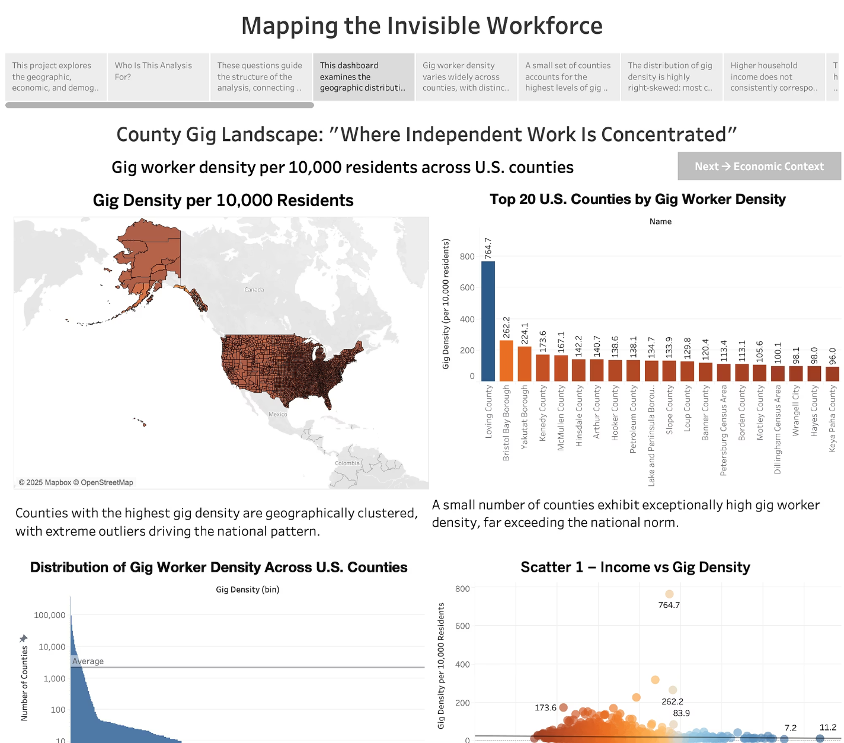
County Gig Landscape: "Where Independent Work Is Concentrated"
This dashboard examines the geographic distribution of gig workers across U.S. counties, highlighting where independent work is most prevalent and how unevenly it is distributed.

Slide 5
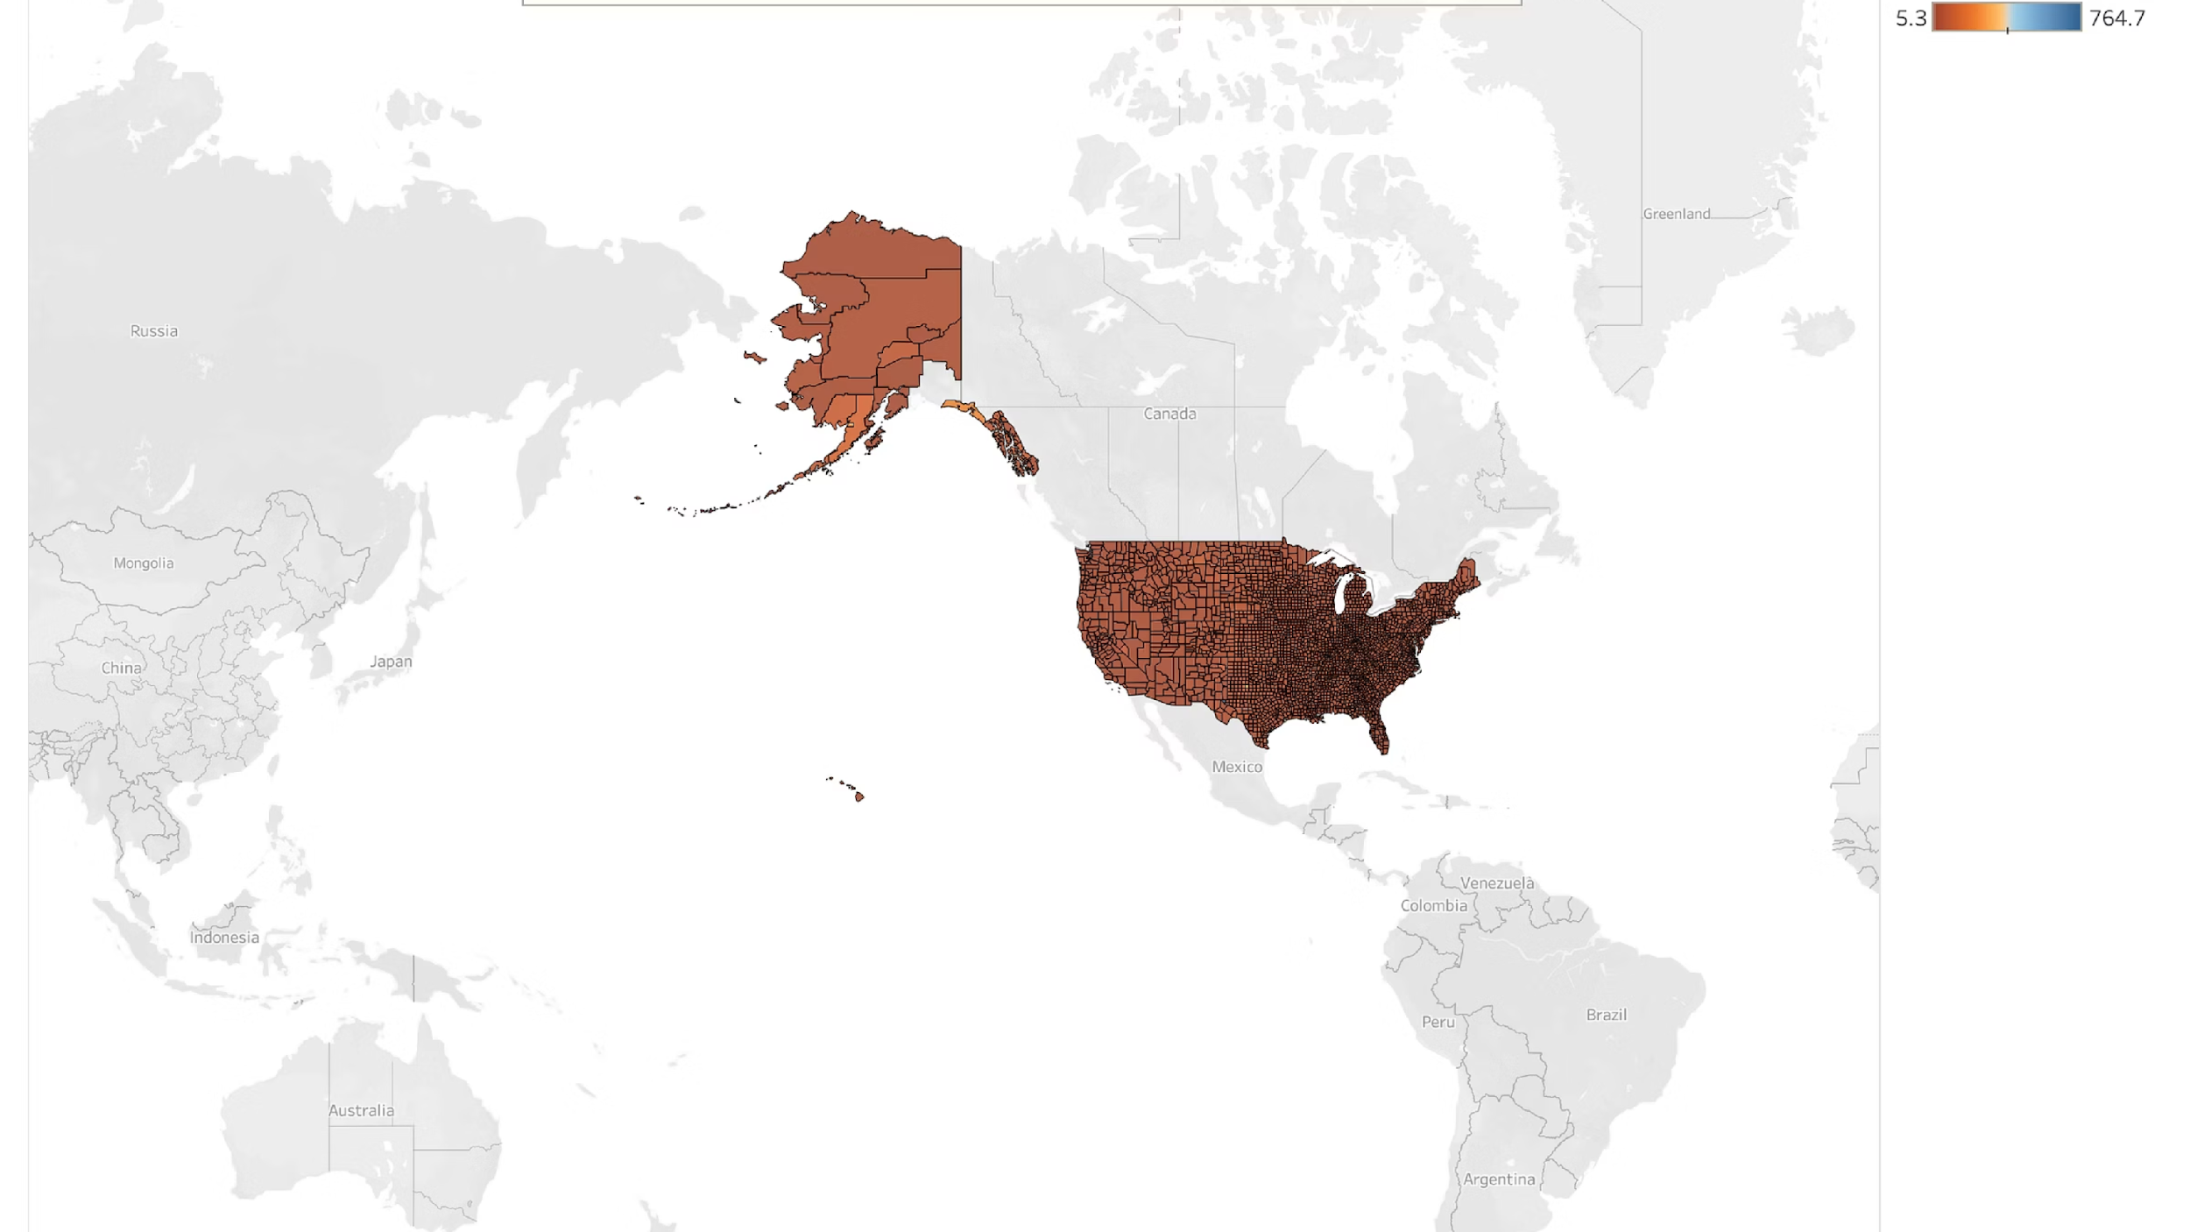
Where Is Gig Work Concentrated?
Gig worker density varies widely across counties, with distinct geographic clustering and a small number of regions exhibiting exceptionally high concentrations of independent work.

Slide 6
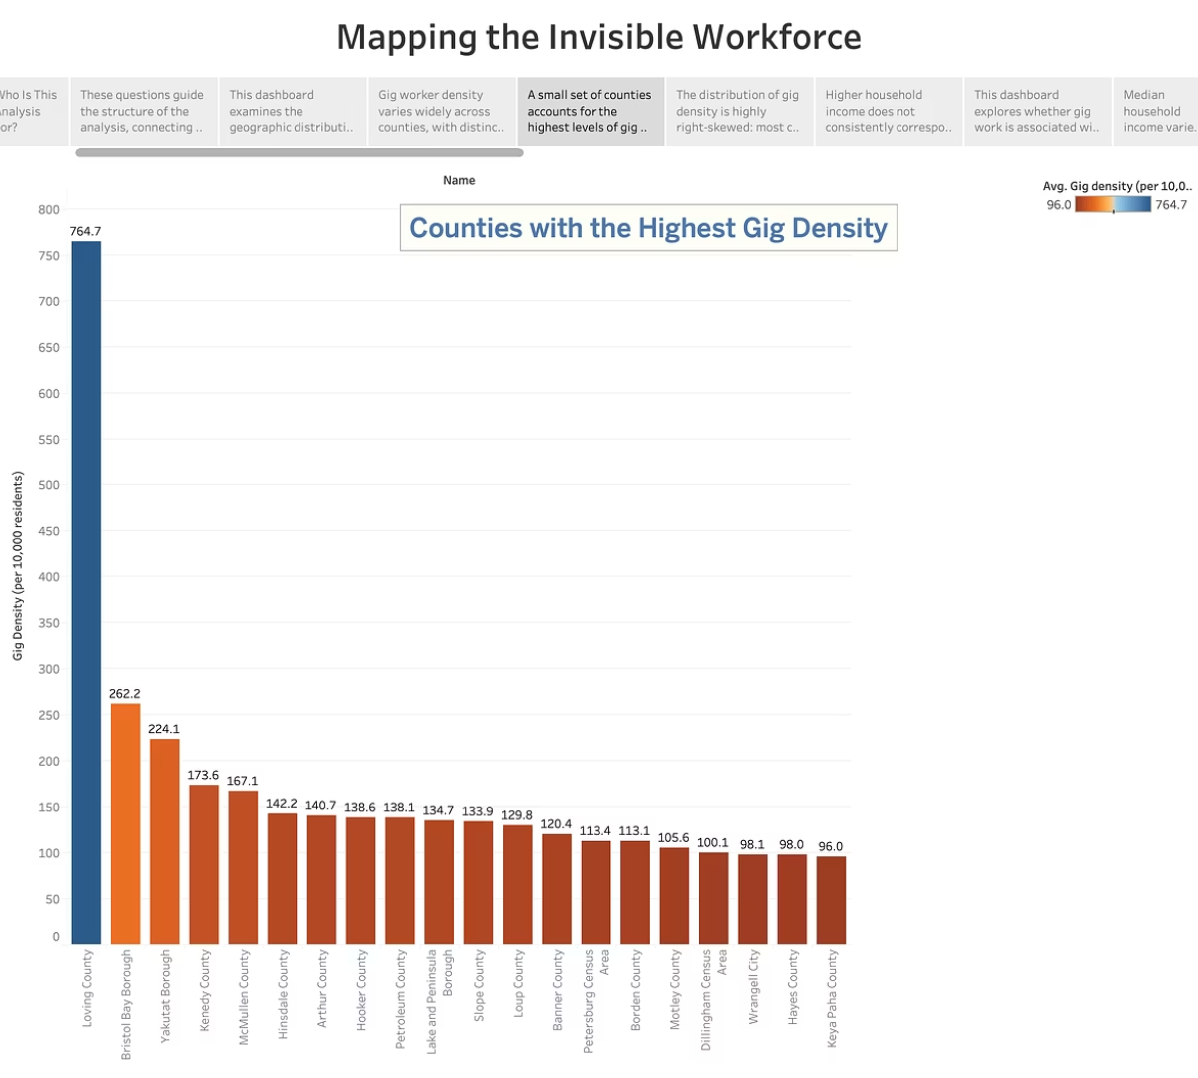
A small set of counties accounts for the highest levels of gig worker concentration, far exceeding national norms and driving much of the observed variation.

Slide 7
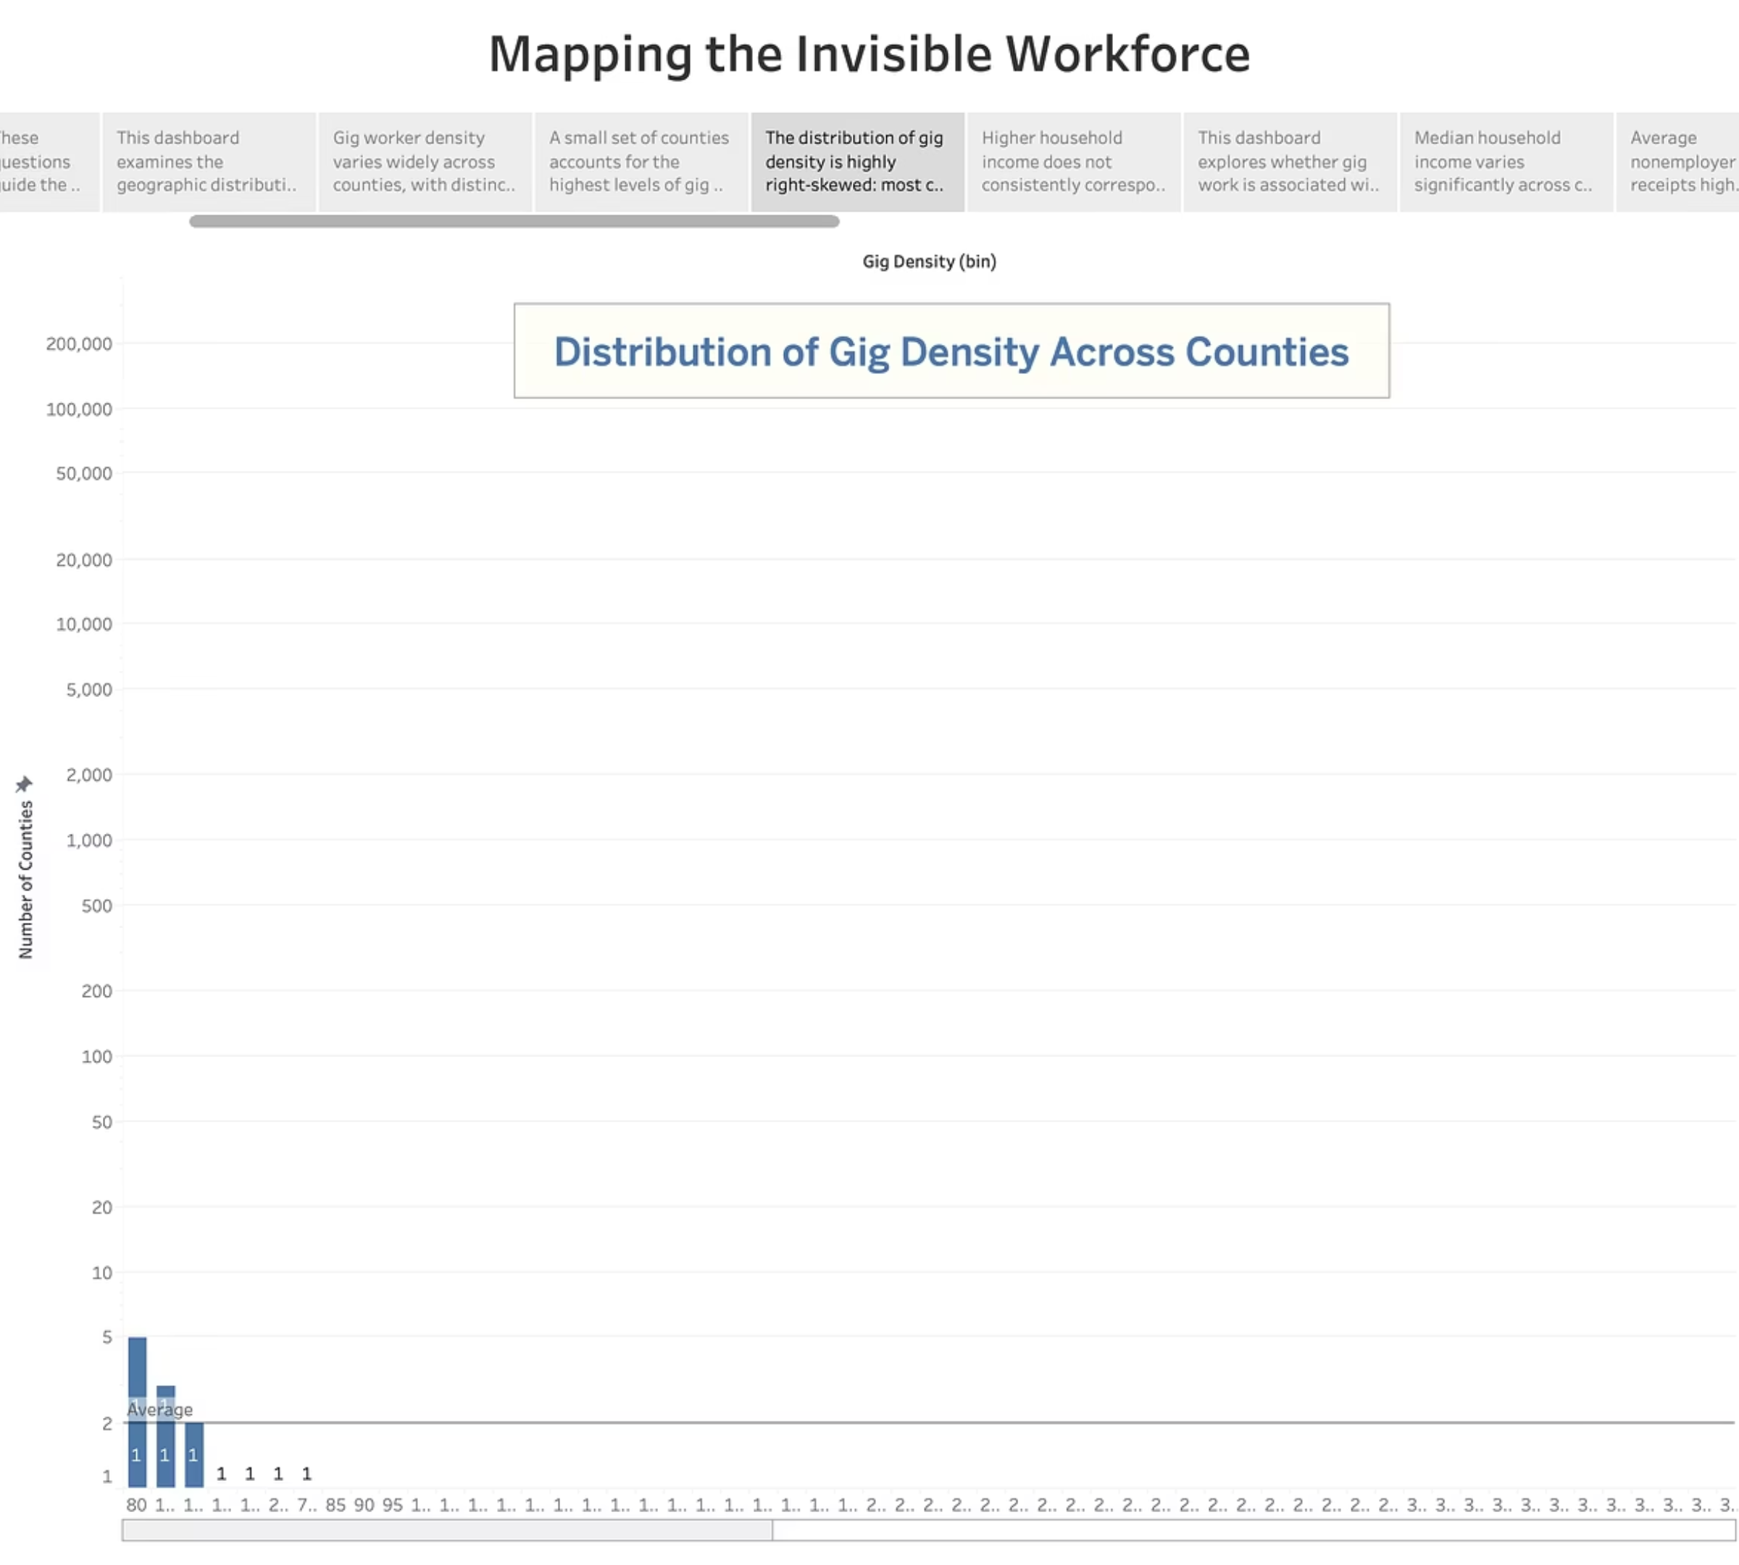
The distribution of gig density is highly right-skewed: most counties have relatively low gig activity, while a few extreme outliers dominate the upper tail.

Slide 8
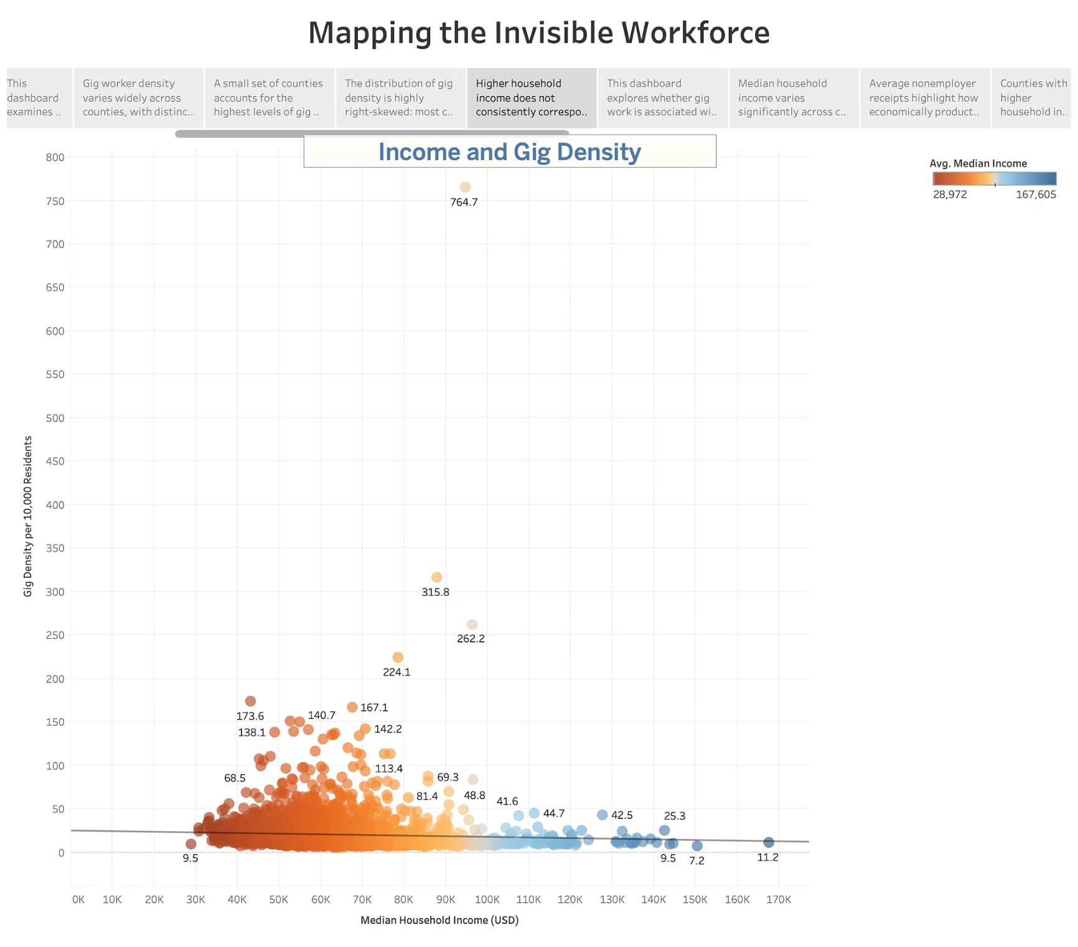
Higher household income does not consistently correspond to higher gig density, suggesting that gig work concentration reflects structural and regional factors beyond income alone.

Slide 9
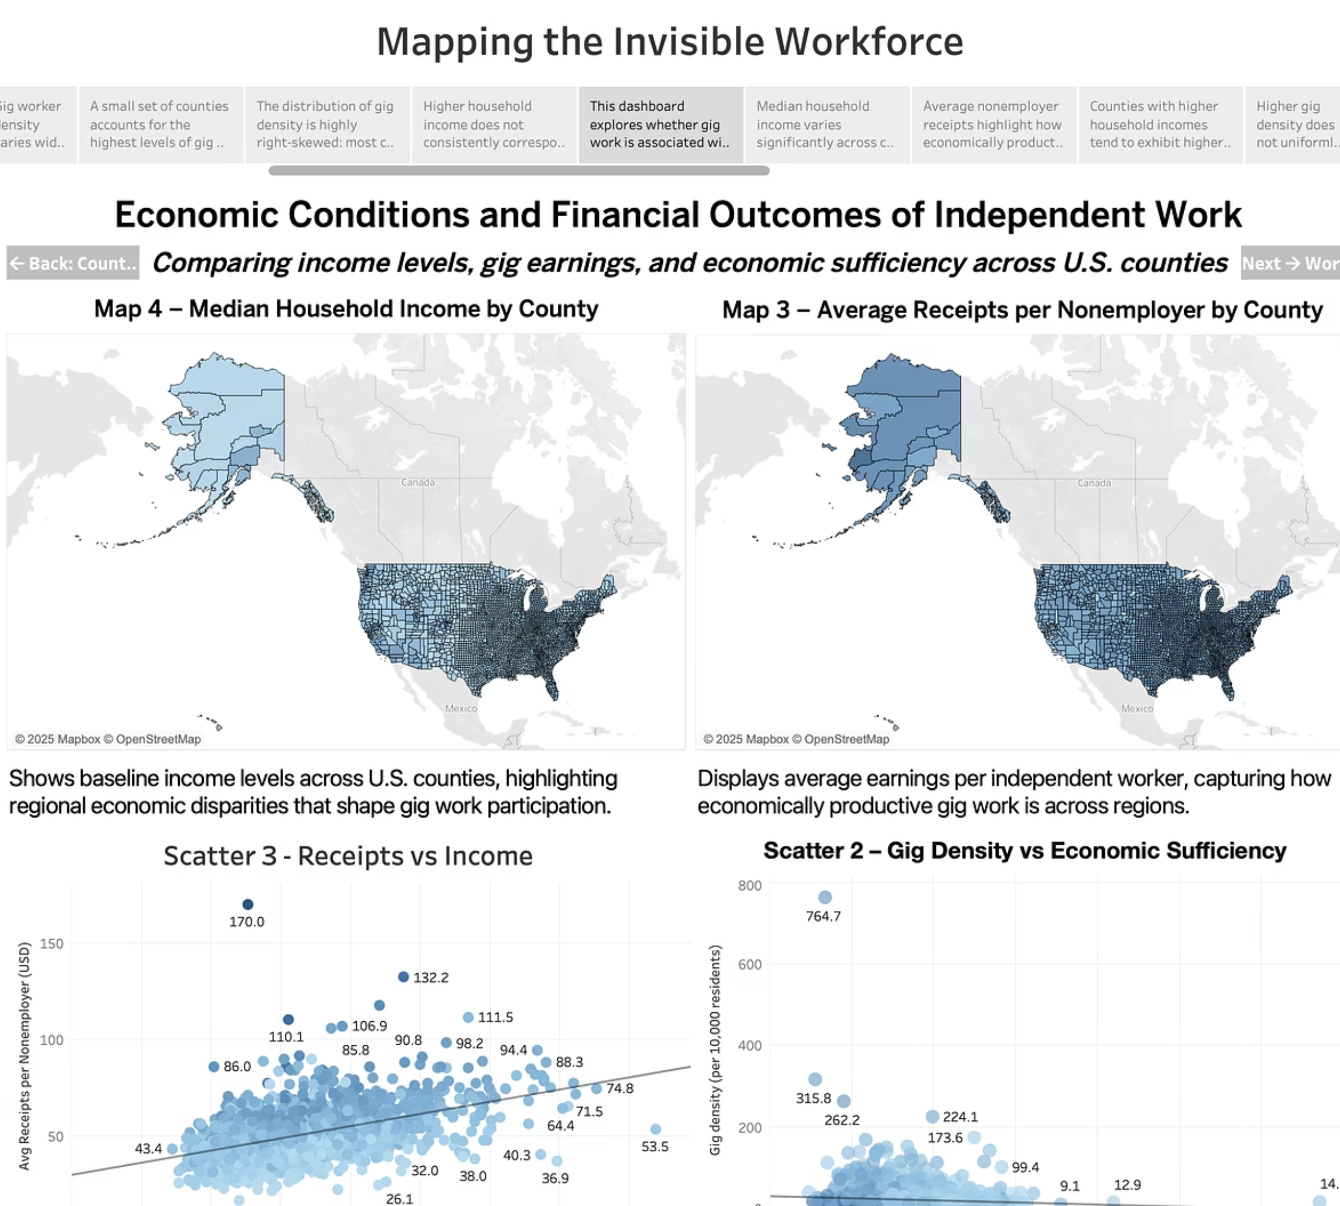
This dashboard explores whether gig work is associated with economic opportunity or economic stress by examining income levels, nonemployer earnings, and economic sufficiency.

Slide 10
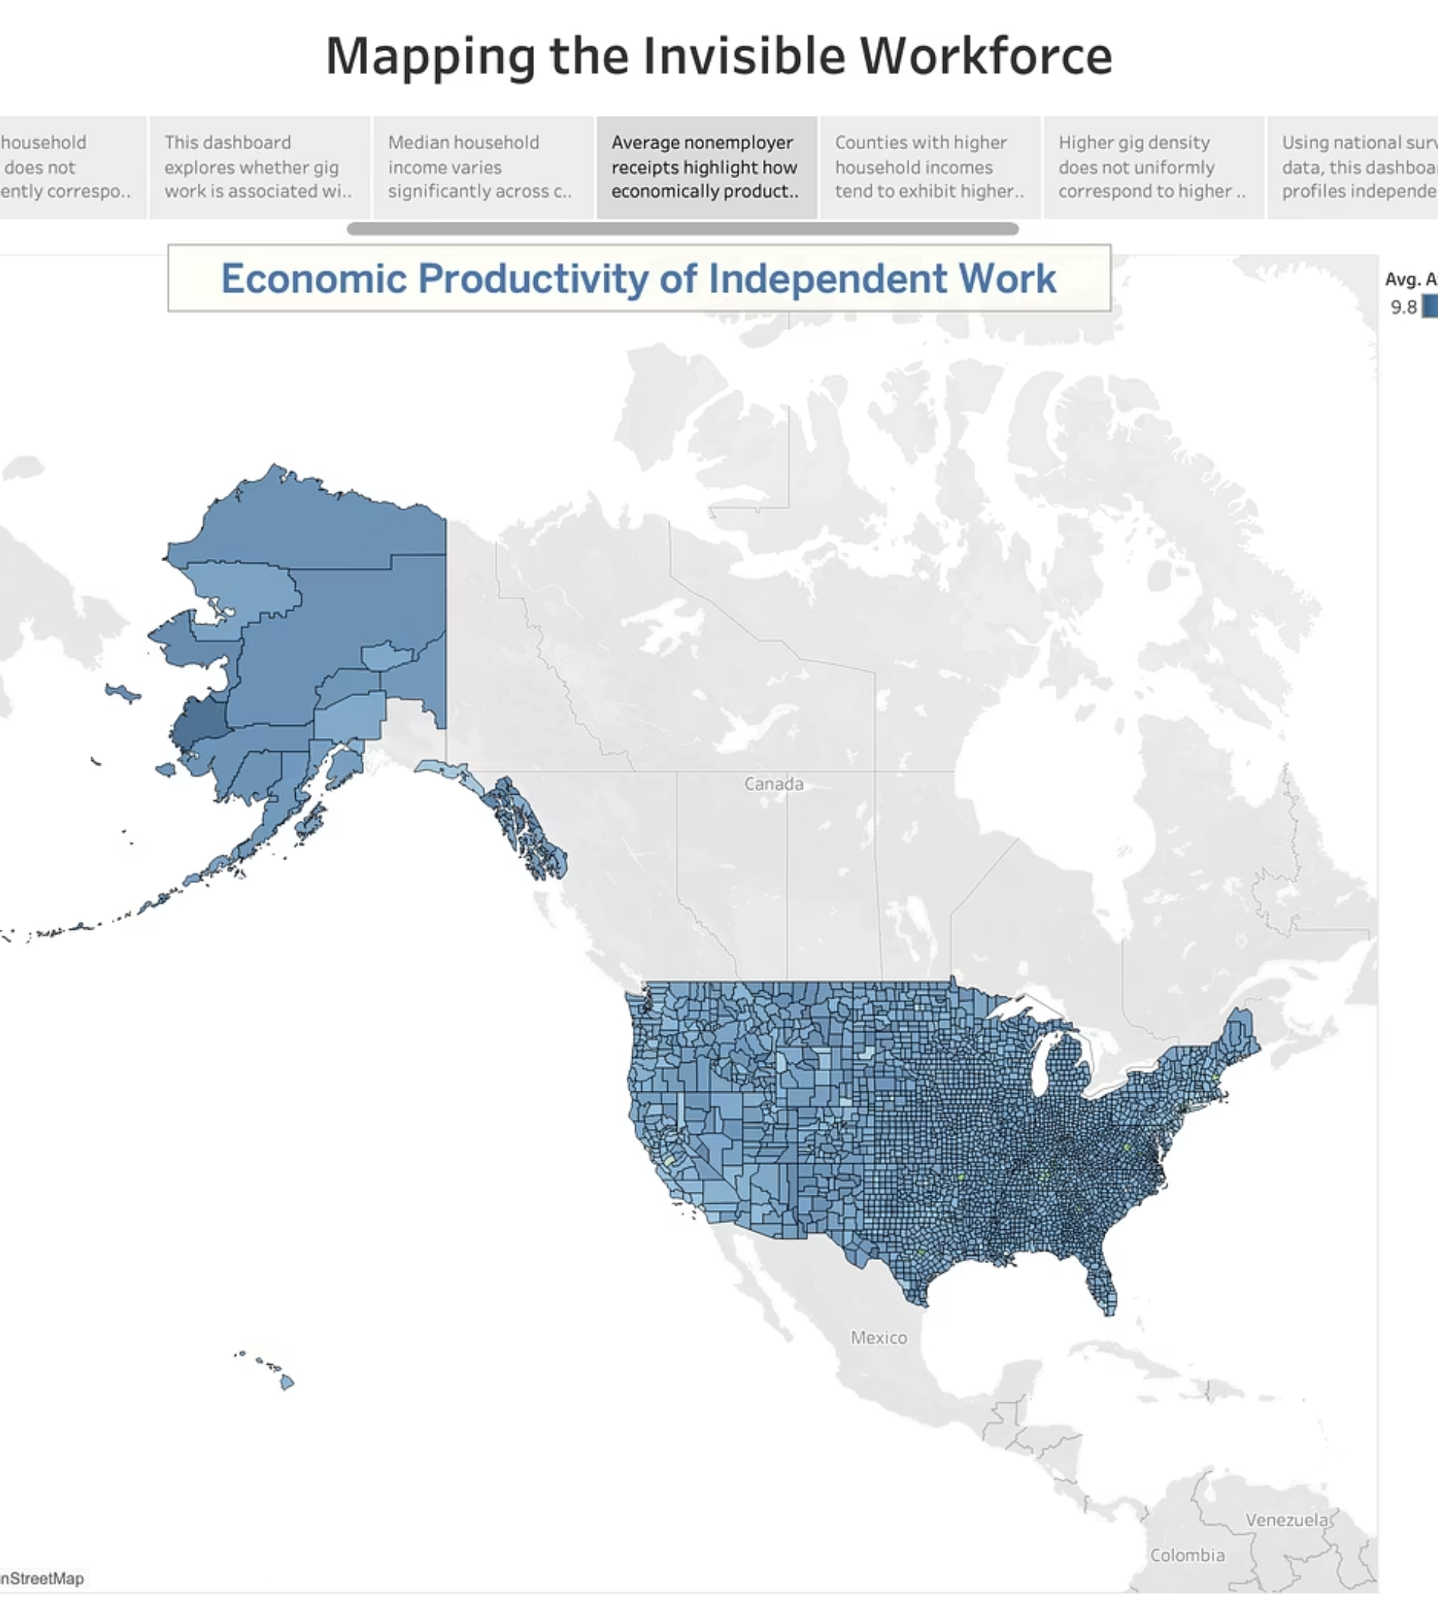
Average nonemployer receipts highlight how economically productive gig work is across regions, revealing substantial geographic differences in earnings potential.

Slide 11
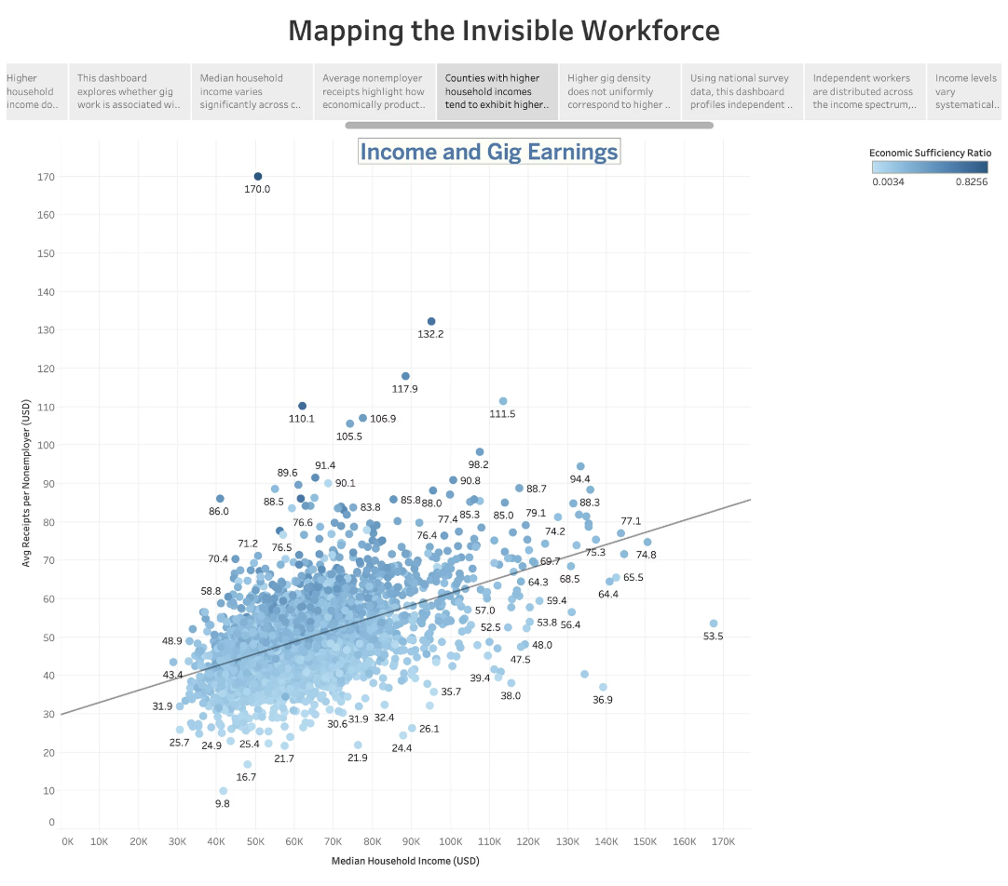
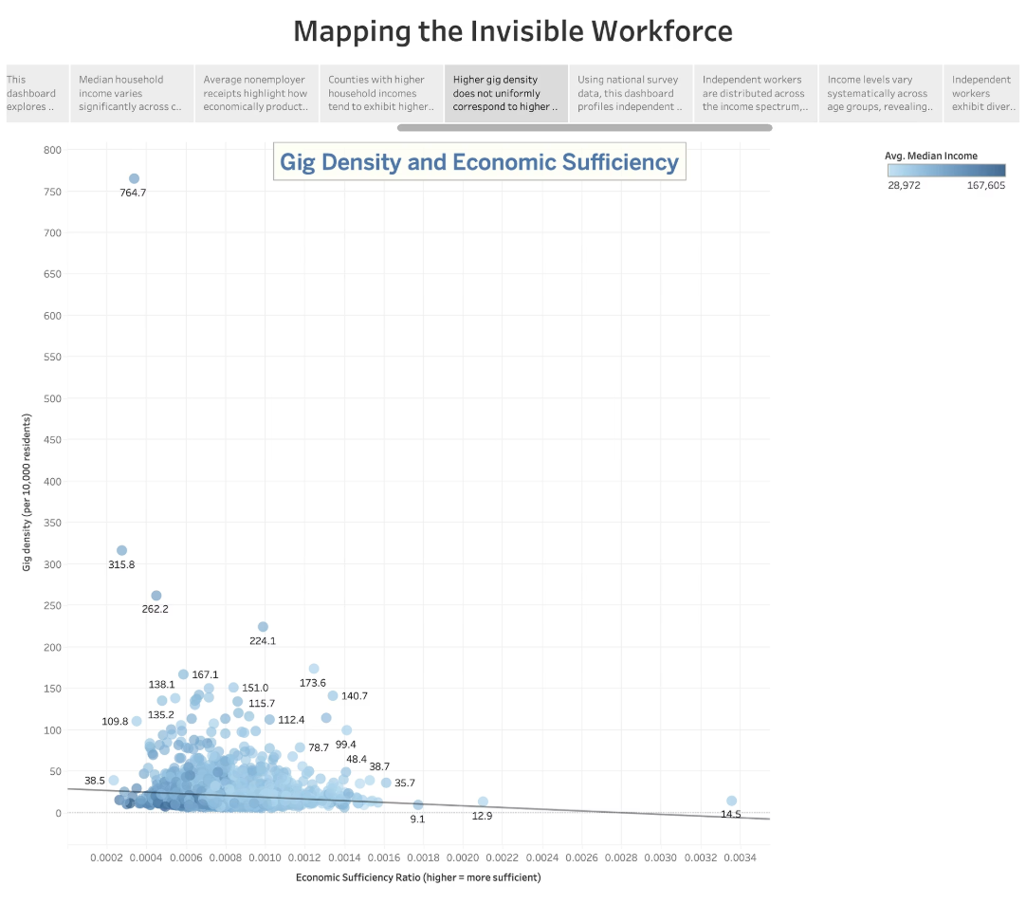
Counties with higher household incomes tend to exhibit higher nonemployer receipts, indicating that local economic strength influences gig earnings capacity.
Higher gig density does not uniformly correspond to higher economic sufficiency, suggesting that gig work may reflect both opportunity and financial necessity.

Slide 12
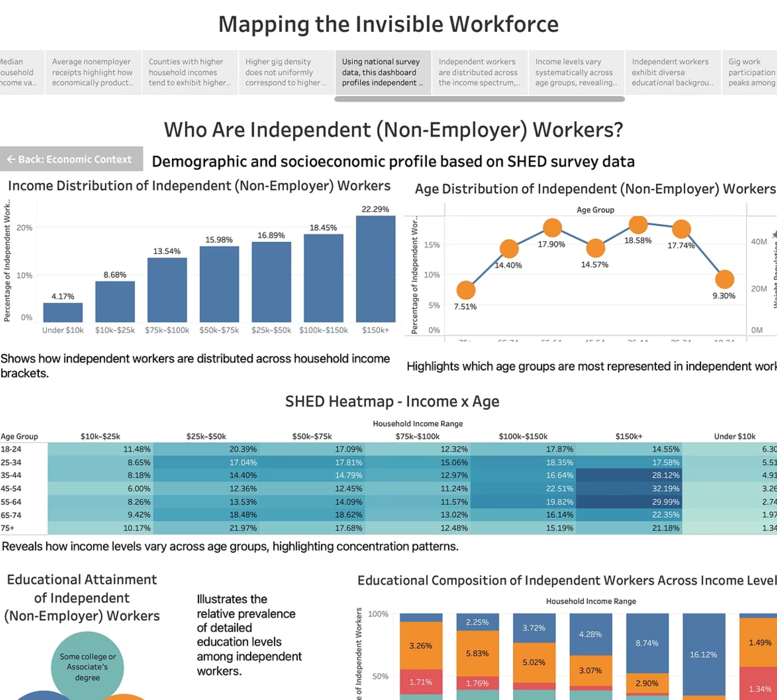
Using national survey data, this dashboard profiles independent workers by income, age, and education to better understand who participates in non-employer work.

Slide 13
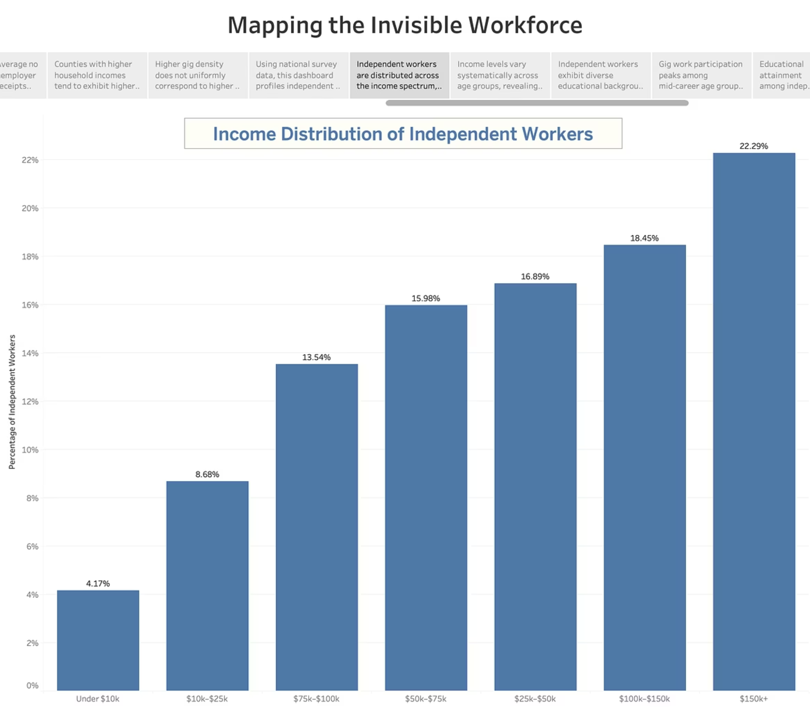
Independent workers are distributed across the income spectrum, with representation in both lower-income and higher-income households.

Slide 14
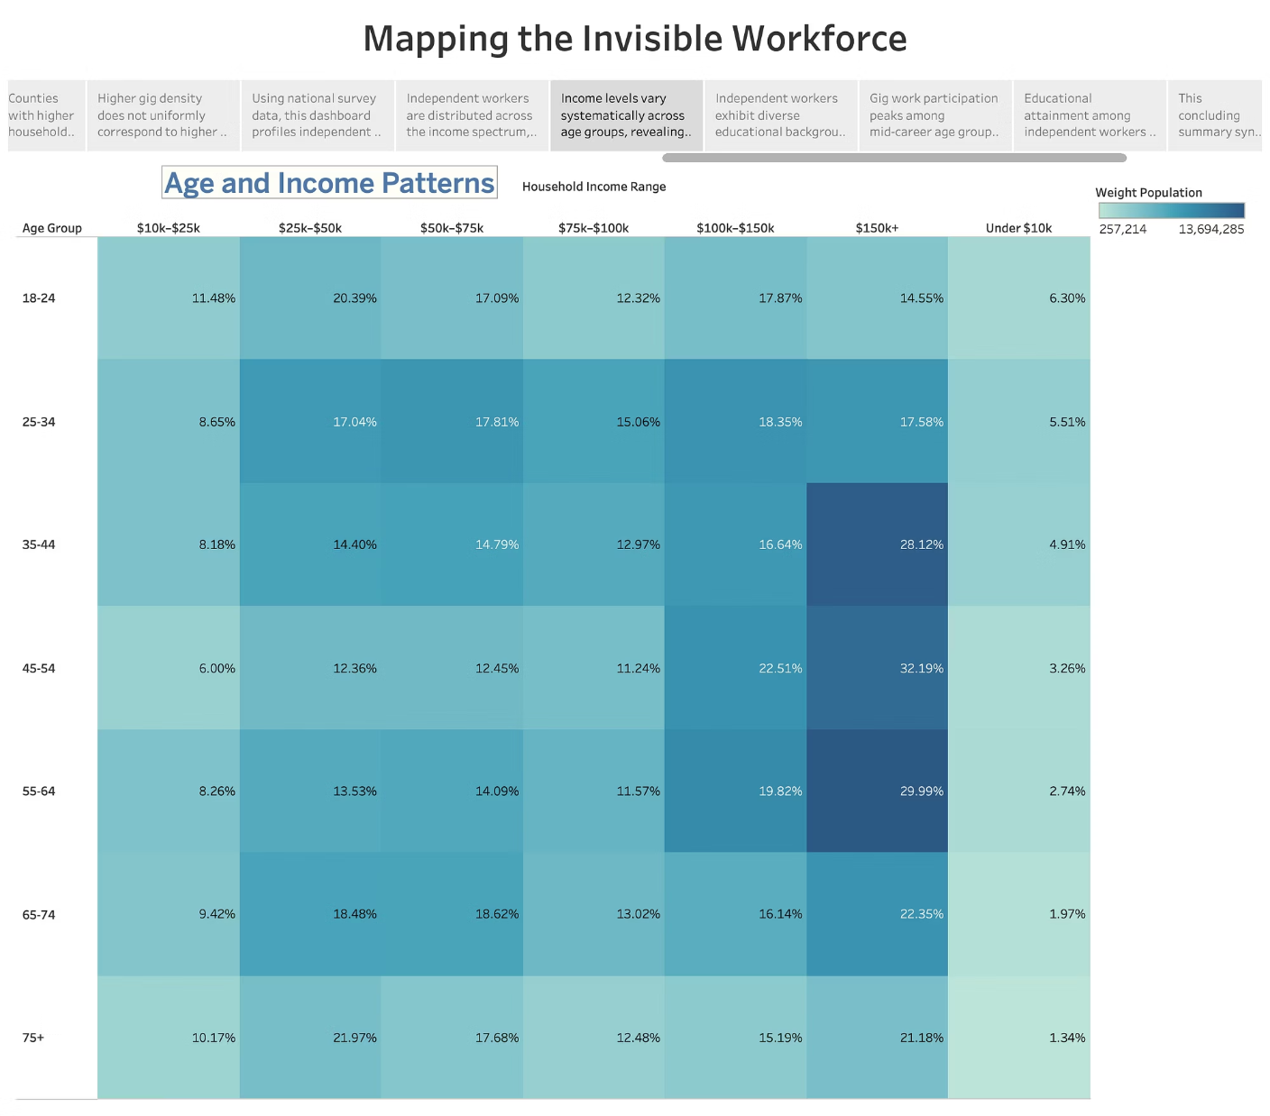
Income levels vary systematically across age groups, revealing distinct life-stage patterns in independent work participation.

Slide 15
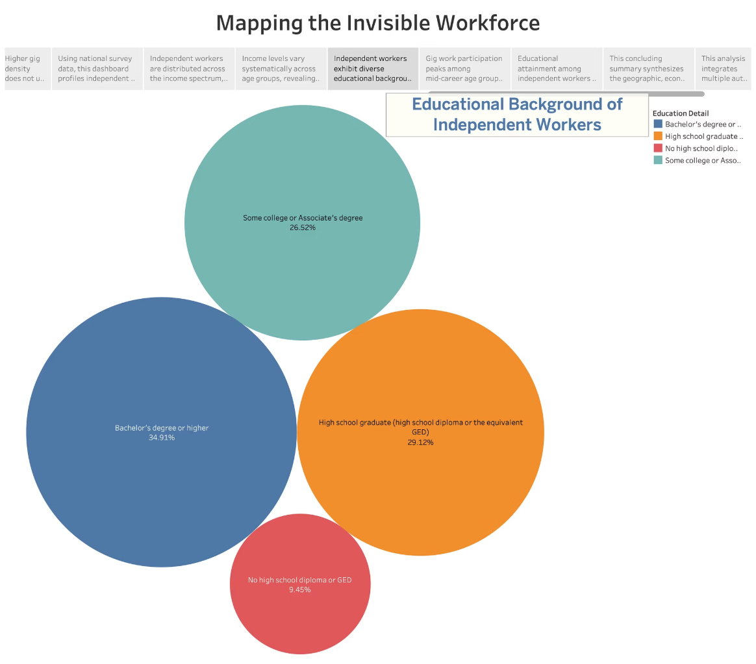
Independent workers exhibit diverse educational backgrounds, with education composition shifting noticeably across income levels.

Slide 16
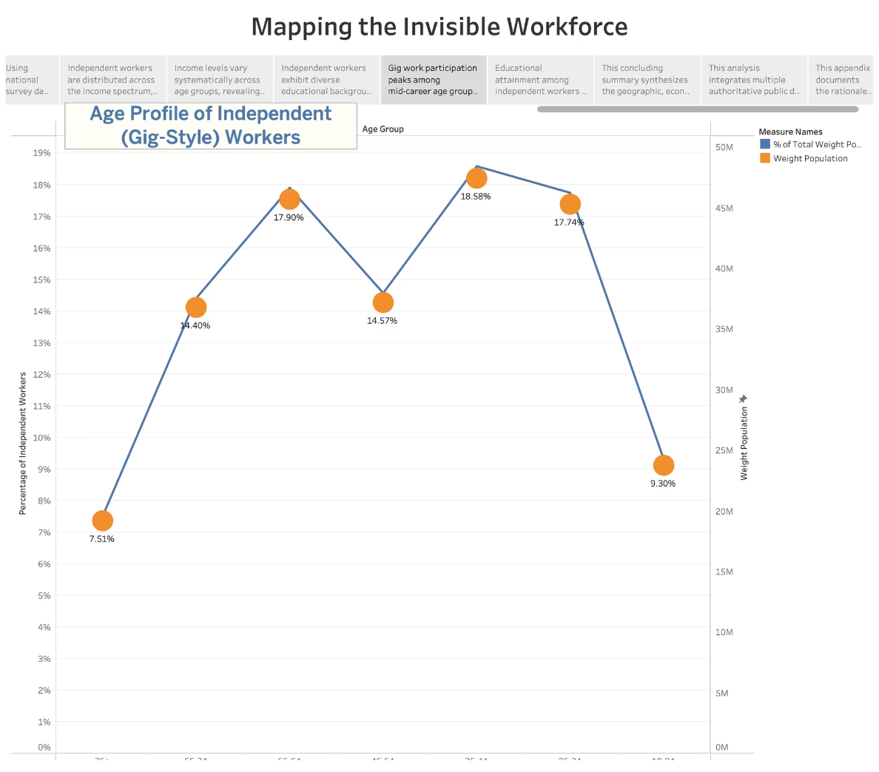
Gig work participation peaks among mid-career age groups, indicating that independent work functions primarily as a core labor strategy rather than a short-term or retirement activity.

Slide 17
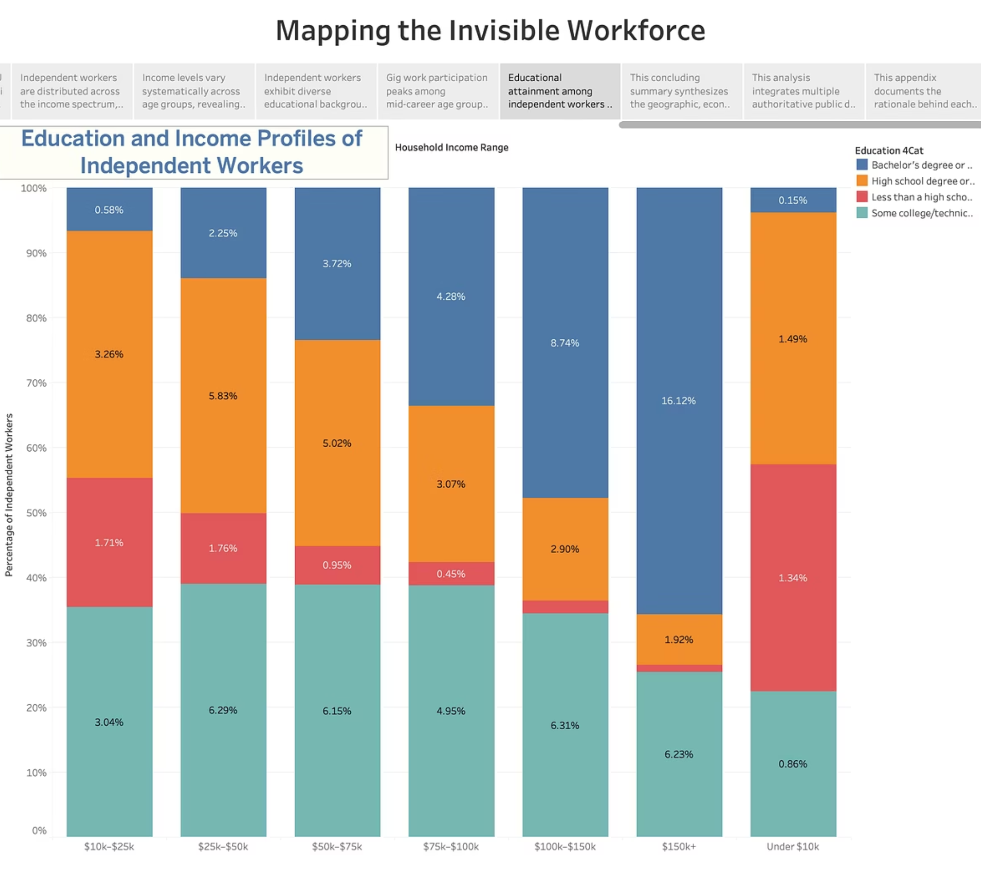
Educational attainment among independent workers rises sharply with income, indicating that higher-earning segments of the gig economy are more strongly linked to formal education, while lower-income segments face structural educational constraints.

Slide 18
Key Takeaways & Implications
Independent gig work in the U.S. shows substantial geographic and economic variation. While some regions exhibit opportunity-driven participation with higher productivity, others reflect necessity-based engagement tied to lower income and cost-of-living pressures. Demographic patterns further highlight the diversity of independent workers across age, income, and education levels. These insights emphasize the need for localized, data-informed labor policies rather than one-size-fits-all solutions.
Future Research Directions
Future analysis could incorporate longitudinal data to examine how gig participation evolves over time, particularly in response to economic shocks, policy interventions, and technological change. Integrating industry-level detail, platform-specific data, and benefits access could further deepen understanding of income stability and long-term sustainability within the gig economy.
As independent work continues to expand and reshape labor markets, understanding where, why, and how gig work occurs is essential for building a more equitable and resilient economic future.

Slide 19
Appendix A - Data Sources & Coverage
1. U.S. Census Bureau - Nonemployer Statistics (NES), 2021 (County-Level)
Dataset Link: https://www.census.gov/data/datasets/2021/econ/nonemployer-statistics/2021-ns.html
Provides county-level counts and total receipts for nonemployer businesses, representing self-employed and gig-style workers. This dataset is used to compute gig worker density and average receipts per nonemployer across U.S. counties.
2. Federal Reserve - Survey of Household Economics and Decisionmaking (SHED), 2022
Dataset Link: https://www.federalreserve.gov/consumerscommunities/shed_data.htm
A nationally representative household survey capturing gig work participation, income reliance, education, age, and financial wellbeing. SHED data is analyzed separately to profile who participates in independent work and their economic conditions.
3. County Health Rankings & Roadmaps (CHR), 2024 Analytic Data
Dataset Link: https://www.countyhealthrankings.org/explore-health-rankings/rankings-data-documentation
(Downloaded: 2024 CHR Analytic Data – CSV)
Provides county-level socioeconomic indicators, including living wage benchmarks and population data. This dataset supports cost-of-living comparisons and the construction of gig income sufficiency metrics.
Together, these datasets enable a multi-layered analysis linking where gig work is concentrated, who participates, and how financially viable independent work is across different regions.

Slide 20
Appendix B - Visualization Design Choices & Justification
1. Choropleth Maps (County-Level)
Used to visualize spatial variation in gig density, income, and economic sufficiency, enabling identification of regional patterns and geographic clustering.
2. Ranked Bar Charts
Used to compare top counties and categorical distributions, supporting clear magnitude comparison and highlighting extreme values.
3. Stacked Bar Charts
Used to analyze proportional composition (e.g., education by income), allowing comparison of category shares within and across income groups.
4. Scatter Plots with Trend Lines
Used to examine relationships between gig density, income, receipts, and economic sufficiency while retaining visibility of outliers and variability.
5. Histograms
Used to display the distribution of gig worker density across counties, revealing skewness and long-tail concentration not visible in averages.
6. Heatmaps
Used to represent multivariate relationships between age groups and income ranges, enabling efficient comparison of intensity across categories.
7. Packed Bubble Charts
Used to summarize education composition among independent workers, emphasizing relative magnitude and categorical share.
Collectively, these visualization choices ensure non-redundant perspectives, reinforce analytical clarity, and support an interactive, narrative-driven exploration of the U.S. gig economy.

